Slide 1
Sequential Circuits

Slide 2
يادآوري
  آموزش تکنيک هاي طراحي و پياده سازي سيستم هاي پيچيده:
سيستم:
  داراي ورودي ها، خروجي ها و رفتار مشخصي است
    اين رفتار توسط تابع هايي تعيين مي شود که ورودي ها را به خروجي ها تبديل (نگاشت) مي کند.
    مثال: گوشي تلفن:
      ورودي ها: کليدها
      خروجي ها: صفحة نمايش و سيگنال هاي ارسالي به مرکز تلفن
      رفتار: شماره گيري و ايجاد ارتباط
    مثال: خودرو:
      ورودي ها: پدال ها، سوييچ، فرمان، ...
      خروجي ها: فرمان پيچش و چرخش چرخ ها، فرمان ترمز، ...
      رفتار: ....
    مثال: تلويزيون

Slide 3
Sequential vs. Combinational
Combinational Logic:
  Output depends only on current input
    TV channel selector (0-9)
Sequential Logic:
  Output depends not only on current input but also on current state of the system (which depends on past input values)
    TV channel selector (up-down)
  Need some type of memory to remember the current state
inputs
system
outputs

Slide 4
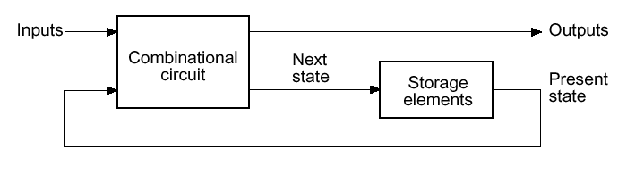
Sequential Logic
Sequential logic circuits
  Remembers past inputs and past circuit state
  Outputs from the system can be “fed back” as new inputs
  The storage elements are circuits that are capable of storing binary information: memory

Slide 5
Feedback Loop
Feedback:
  A signal s1 depends on another signal whose value depends on s1
    There can be several intermediate signals
s1

Slide 6
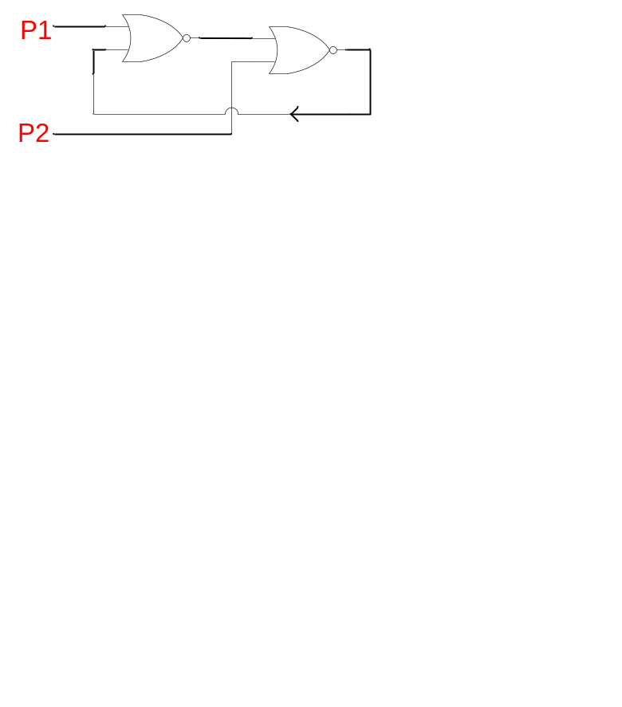
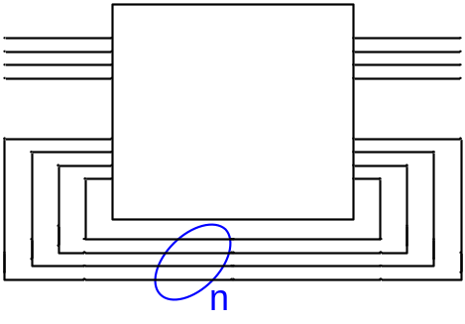
Base of Memory
  Consider the following circuit:
  The feedback line can keep one of two values, 0 or 1.
  Previous circuits (combinational) had no feedback
  A circuit with n feedback lines has 2^{n} potential states, and that the memory of our circuit depends on the number of its feedback lines:
P1 = P2 = 0

Slide 7
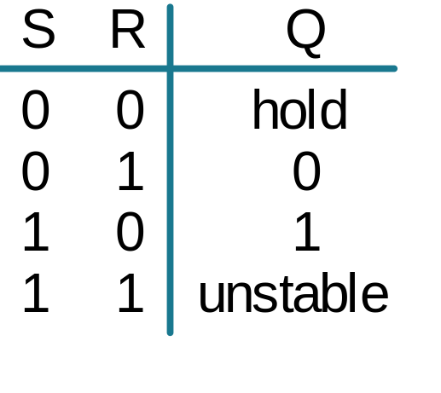
SR Latch (NOR version)
R
Q
Q
R
S
S
Q’
Truth Table:
Next State = F(S, R, Current State)
S(t) R(t) Q(t) Q(t+)
0 0 0 0 (hold)
0 0 1 1 (hold)
0 1 0 0 (reset)
0 1 1 0 (reset)
1 0 0 1 (set)
1 0 1 1 (set)
1 1 -- Not allowed

Slide 8
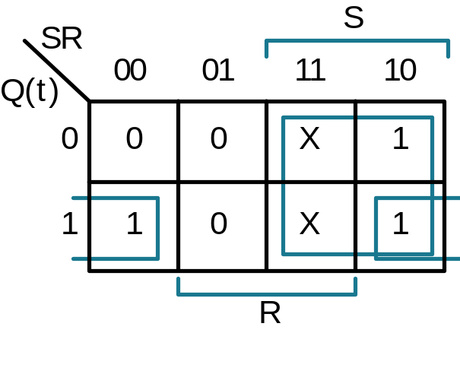
SR Latch
Truth Table:
Next State = F(S, R, Current State)
Derived K-Map:
S(t) R(t) Q(t) Q(t+)
0 0 0 0 (hold)
0 0 1 1 (hold)
0 1 0 0 (reset)
0 1 1 0 (reset)
1 0 0 1 (set)
1 0 1 1 (set)
1 1 0 Not allowed
1 1 1 Not allowed
Characteristic Equation:
Q+ = S + R Q
t

Slide 9
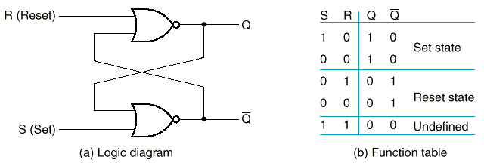
R=S=1 ??
Not allowed, because
  When S=R=1, both outputs go to zero
  If both inputs now go to 0, the state of the SR latch depends on delays
  Hence, “undefined” state
    MUST be avoided

Slide 10
Timing Diagram
Reset
Hold
Set
Reset
Set
100
Race
R
S
Q
Q’
Forbidden
State
Forbidden
State

Slide 11
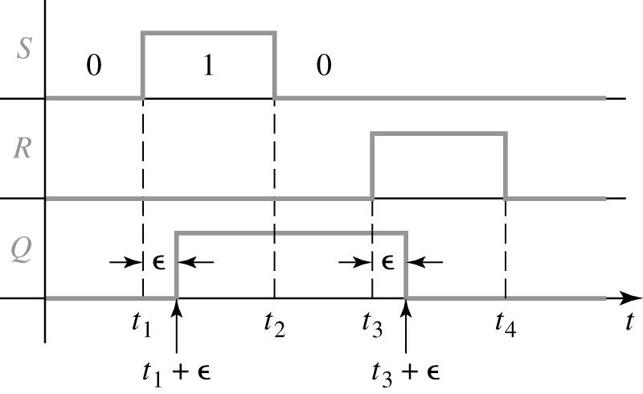
Timing Diagram of SR Latch
  Note: the delay from S to Q in this timing diagram should be 2ε because from S to Q there are two gate delays

Slide 12
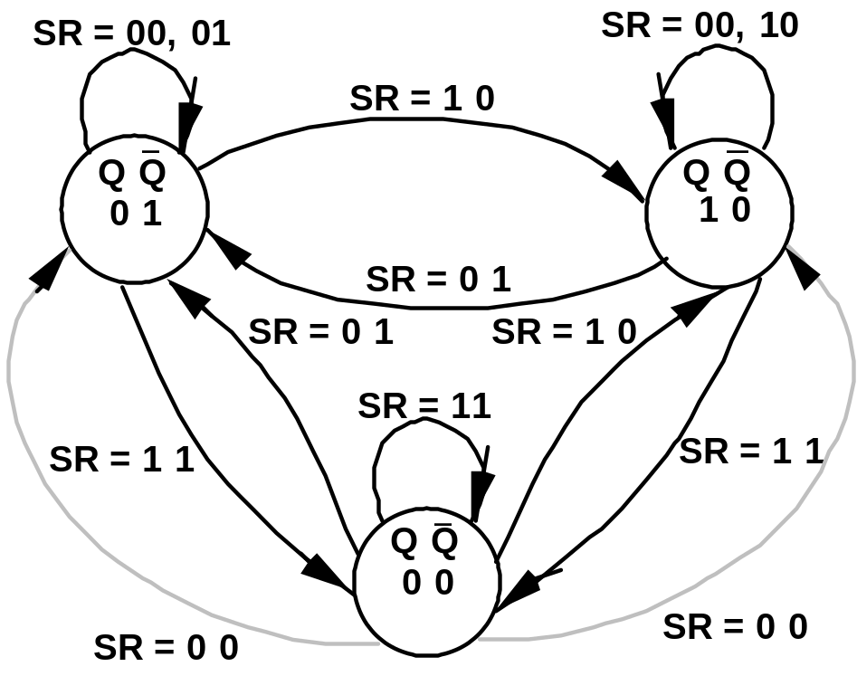
SR Latch State Diagram
Observed State Diagram
Q Q
Q Q
0 1
1 0
Q Q
0 0
  Very difficult to observe SR latch after the 0-0 state
  Ambiguously returns to state 0-1 or 1-0

Slide 13
S’R’ Latch (NAND version)
0
S’
S’ R’ Q Q’
Q
1
0 0
0 1
1 0
1 1
1 0 Set
Q’
0
1
R’
X Y NAND
0 0 1
0 1 1
1 0 1
1 1 0

Slide 14
S’R’ Latch (NAND version)
1
S’
S’ R’ Q Q’
Q
1
0 0
0 1
1 0
1 1
1 0 Set
Q’
0
1
R’
1 0 Hold
X Y NAND
0 0 1
0 1 1
1 0 1
1 1 0

Slide 15
S’R’ Latch (NAND version)
1
S’
S’ R’ Q Q’
Q
0
0 0
0 1
1 0
1 1
1 0 Set
0 1 Reset
Q’
1
0
R’
1 0 Hold
X Y NAND
0 0 1
0 1 1
1 0 1
1 1 0

Slide 16
S’R’ Latch (NAND version)
1
S’
S’ R’ Q Q’
Q
0
0 0
0 1
1 0
1 1
1 0 Set
0 1 Reset
Q’
1
1
R’
1 0 Hold
0 1 Hold
X Y NAND
0 0 1
0 1 1
1 0 1
1 1 0

Slide 17
S’R’ Latch (NAND version)
0
S’
S’ R’ Q Q’
Q
1
0 0
0 1
1 0
1 1
1 1 Not allowed
1 0 Set
0 1 Reset
Q’
1
0
R’
1 0 Hold
0 1 Hold
X Y NAND
0 0 1
0 1 1
1 0 1
1 1 0

Slide 18
SR Latch with Control (Enable)
S
S’
Q
C
Q’
R
R’
S R C S’ R’ Q Q’
0 0 1 1 1 Q₀ Q₀’ Hold
0 1 1 1 0 0 1 Reset
1 0 1 0 1 1 0 Set
1 1 1 0 0 1 1 Not allowed
X X 0 1 1 Q₀ Q₀’ Hold

Slide 19
D Latch (cont.)
S
D
S’
Q
C
Q’
R
R’
S R C Q Q’
D C Q Q’
0 0 1 Q₀ Q₀’ Store
0 1 1 0 1 Reset
1 0 1 1 0 Set
1 1 1 1 1 Not allowed
X X 0 Q₀ Q₀’ Store
0 1 0 1
1 1 1 0
X 0 Q₀ Q₀’

Slide 20
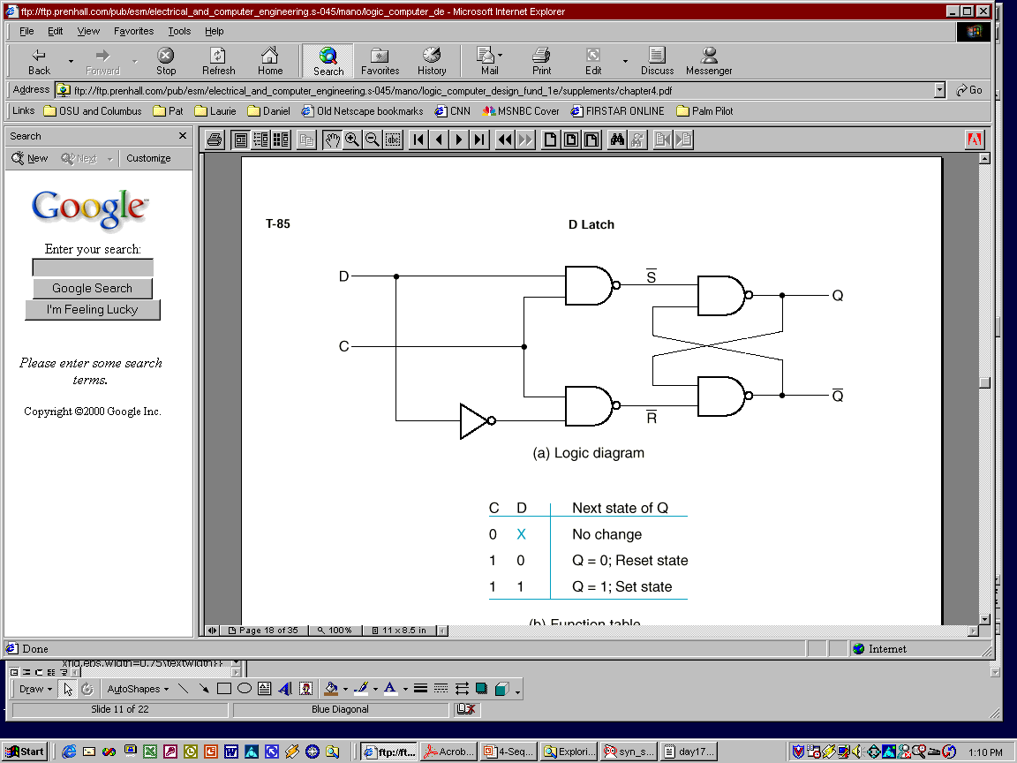
D Latch
  SR latches are useful in control applications,
    where we often think in terms of setting a flag in response to some condition, and resetting it when conditions change
  We often need latches simply to store bits presented on a signal line
  → D latch (i.e., Data latch)
  Can eliminate the undesirable indeterminate state in the SR latch:
    ensures that inputs S and R are never simultaneously 1
D
Q
D
Latch
Q’
C

Slide 21
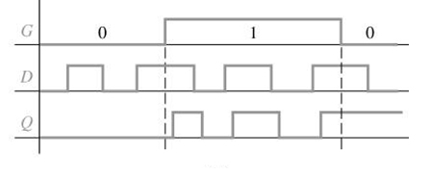
D Latch Timing Diagram
D
Q
D
Latch
Q’
G
C

Slide 22
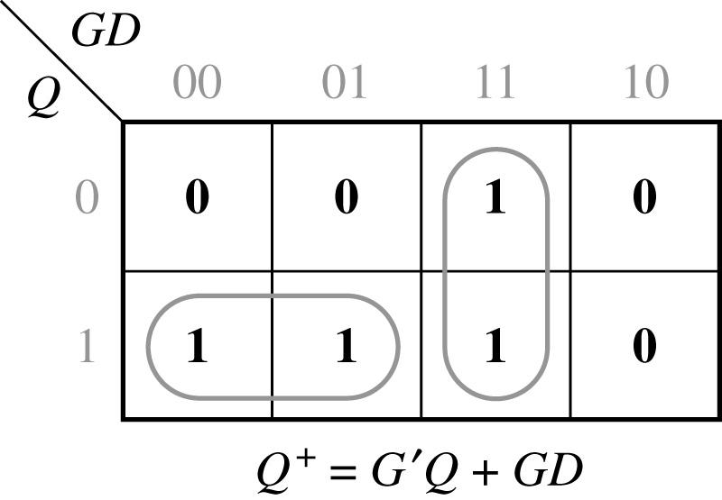
D-Latch Characteristic Equation
D
Q
D
Latch
Q’
C
C D Q | Q+
0 0 0 0 0 1 0 1 0 0 1 1 1 0 0 1 0 1 1 1 0 1 1 1 | 0 1 0 1 0 0 1 1
C D
C
0
1
D
0
Q
0
1
Q
1
Q+ = C’.Q + C.D

Slide 23
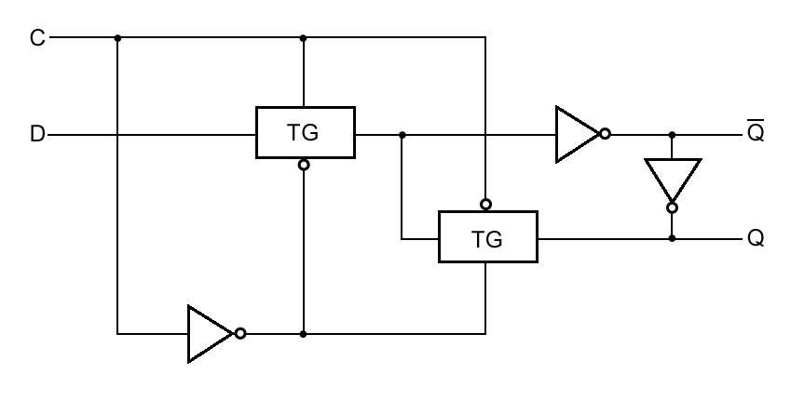
D Latch with Transmission Gates
1
2
C=1 → TG1 closes and TG2 opens → Q’=D’ and Q=D
C=0 → TG1 opens and TG2 closes → Hold Q and Q’

Slide 24
JK Latch
J
Q
J, K both 1 => toggle
K
Q’
J(t) K(t) Q(t) Q(t+)
0 0 0 0 (hold)
0 0 1 1 (hold)
0 1 0 0 (reset)
0 1 1 0 (reset)
1 0 0 1 (set)
1 0 1 1 (set)
1 1 0 1 (toggle)
1 1 1 0 (toggle)
JK Latch
Derived K-Map:
JK
J
Q
(
t
)
00
01
11
10
0
0
0
1
1
1
1
0
0
1
K
Characteristic Equation:
Q+ = Q K’ + Q’ J

Slide 25

JK Latch Using SR Latch
How to eliminate the forbidden state in SR?
Idea:
-Use output feedback to guarantee that
R and S inputs are never both one
AND
-that J, K both one yields a toggle
S
Q
Q
J
SR
latch
K
R
Q’
Q’
J(t) | K(t) | Q(t) | Q(t+Δ)
0 0 | 0 0 | 0 1 | 0 HOLD 1
0 0 | 1 1 | 0 1 | 0 RESET 0
1 1 | 0 0 | 0 1 | 1 SET 1
1 1 | 1 1 | 0 1 | 1 TOGGLE 0
Characteristic Equation:
Q+ = Q K + Q J

Slide 26
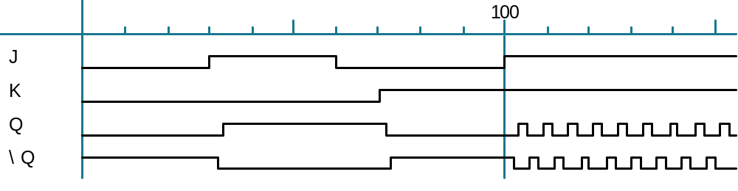
JK Latch Race Condition
Set
Reset
Toggle
Toggle correctness condition: single state changes
Solution: Master/Slave flip-flop

Slide 27
Flip-Flops
  Latches are “transparent” (= any change on the inputs is seen at the outputs after some delay)
  This may cause synchronization problems!
  Solution: use latches to create flip-flops that can respond (update) ONLY on SPECIFIC times (instead of ANY time)

Slide 28
Alternatives in FF choices
Types of FF
  RS
  D
  JK
  T

Slide 29



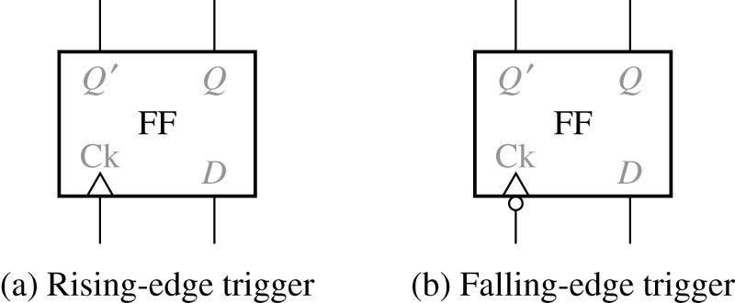
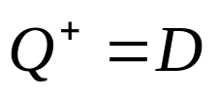
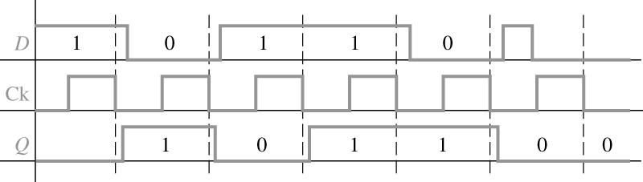
D-FF
The most common type of FF
0 0 0 1 1 0 1 1 | 0 0 1 1
Truth table
Timing for D Flip-Flop (Falling-Edge Trigger)

Slide 30
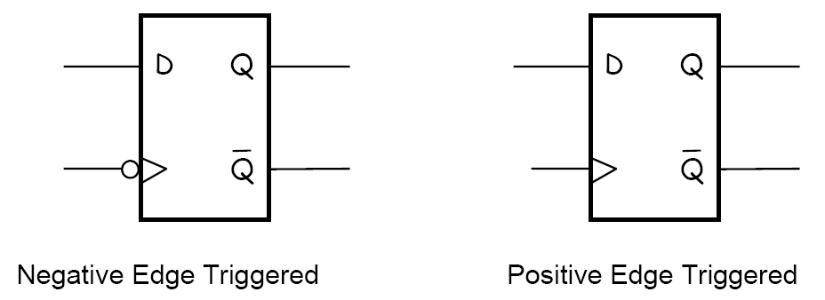
Symbols
Notes:
  The small triangles in the symbol show that it is a FF not a latch
  The small bubbles show the positive or negative edge

Slide 31
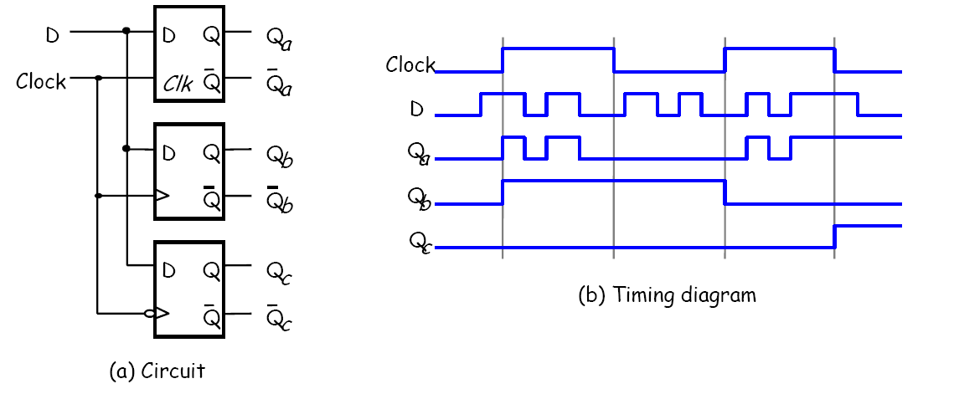
Compare Latch with FF’s
Top device is a latch (how do we know?)
Bottom two are rising and falling edge flip-flops
Delays not considered for simplicity

Slide 32
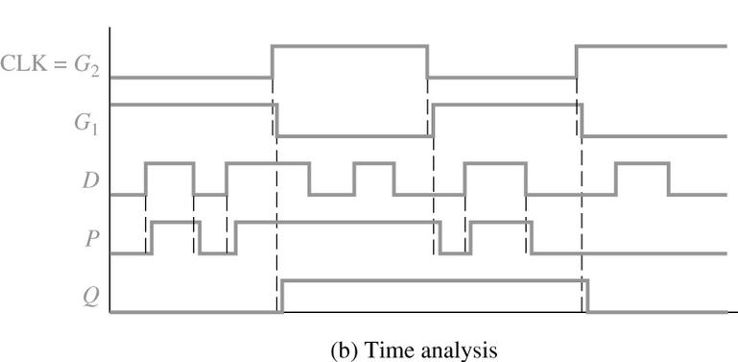
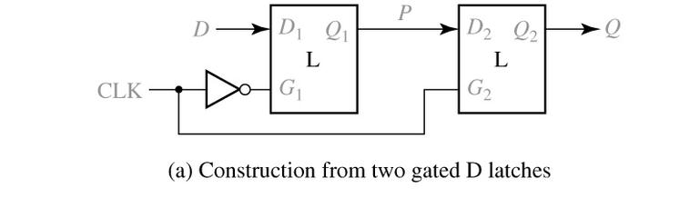
Rising Edge D-FF:
How to make?
One way is to use 2 cascaded latches
What about falling-edge circuit?

Slide 33
Setup Time, Hold Time and Propagation Delay
Setup time:
  D input must be stable for a certain amount of time BEFORE the active edge of clock
Hold time:
  D input must be stable for a certain amount of time AFTER the active edge of the clock
Propagation Delay (Clock-to-Output):
  From the time the clock changes to the time the output changes
Propagation Delay (Data-to-Output):
  From the time the data changes to the time the output changes
  Mainly defined for latches

Slide 34
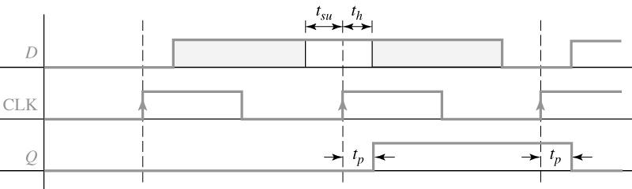
Setup & Hold Time and Propagation Delay
Setup and hold times for a rising edge-triggered D flip-flop
t_{pLH} may be different than t_{pHL}
t_{p} clock-to-output vs. t_{p} D-to-output

Slide 35
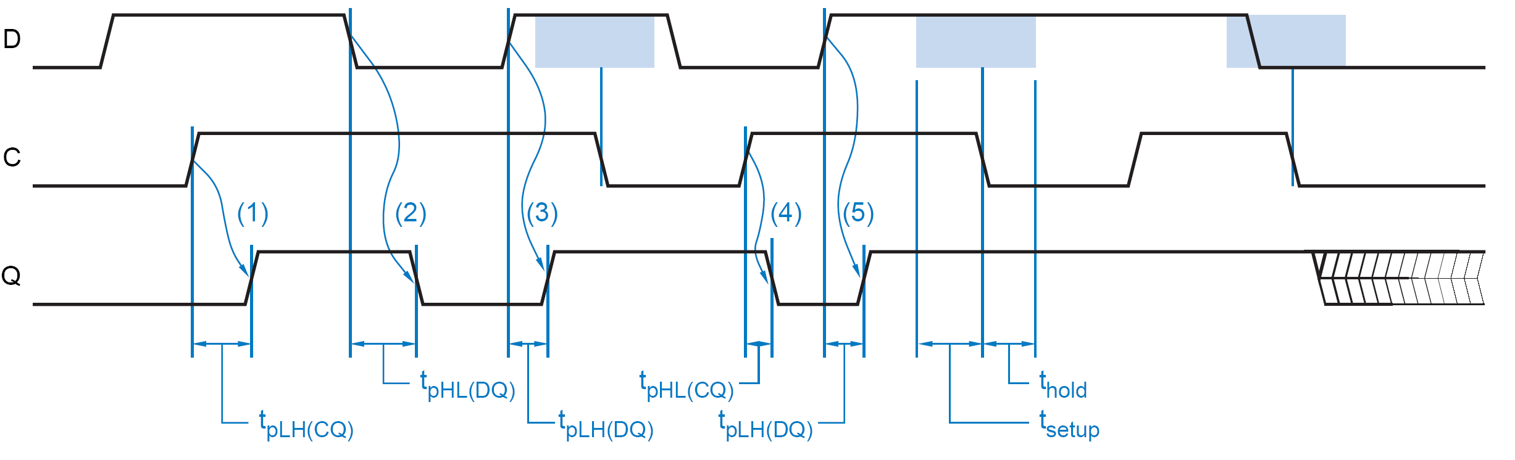
Timing Parameters of a D-Latch

Slide 36
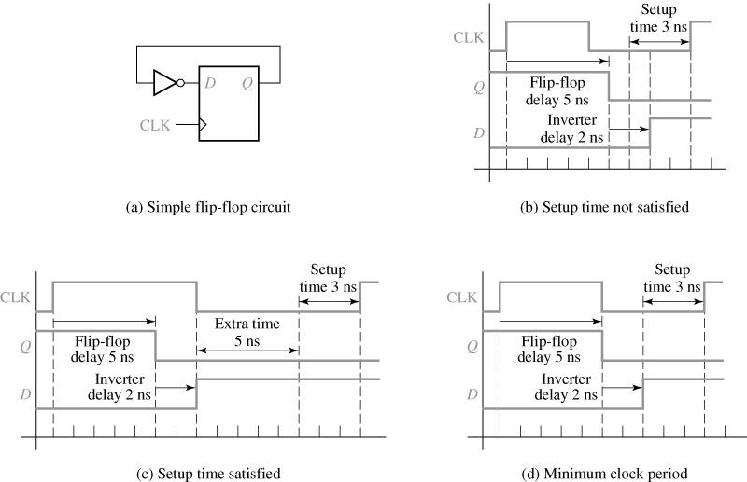
Timing Requirements
Determination of minimum clock period
Assume:
t_{co}= 5 ns
t_{p,inv} = 2 ns
t_{su}= 3 ns

Slide 37
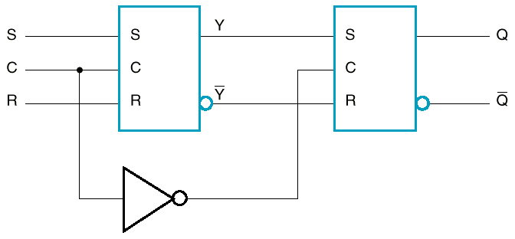
Master-Slave FF configuration using SR latches
Enables edge-triggered behavior

Slide 38
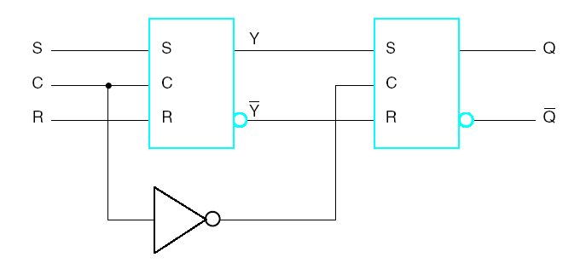
Master-Slave FF configuration
using SR latches (cont.)
S R C Q Q’
When C=1, master is enabled and
stores new data, slave stores old
data.
When C=0, master’s state passes
to enabled slave (Q=Y), master not
sensitive to new data (disabled).
0 0 1 Q₀ Q₀’ Store
0 1 1 0 1 Reset
1 0 1 1 0 Set
1 1 1 1 1 Disallowed
X X 0 Q₀ Q₀’ Store
Master
Slave

Slide 39
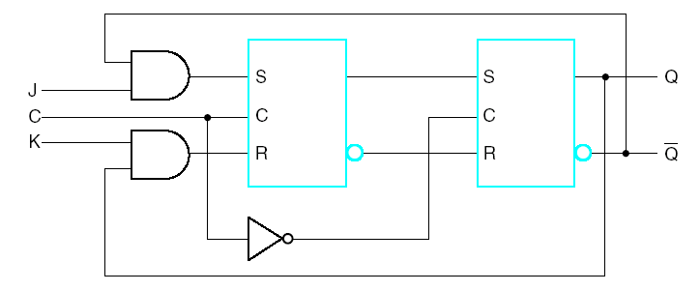
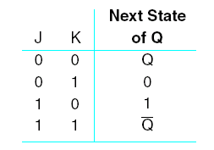
Master-Slave J-K Flip-Flop

Slide 40
Master-Slave J-K Flip-Flop
P
P’
Master samples inputs while clock high
Slave samples inputs while clock low
1's
Set
Reset
Catch
T
oggle
100
Correct toggle
operation but catches J or K glitches!
J
K
C
P
Master
P‘
outputs
‘
Q
Slave
Q’
outputs

Slide 41
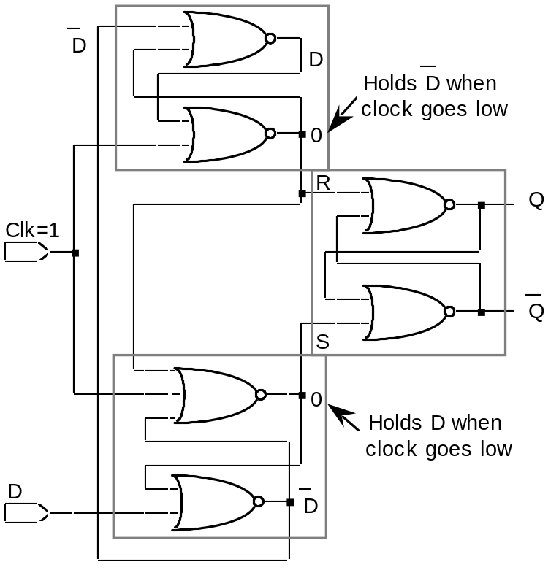
Edge-Triggered FF
Problem with a Master-Slave FF:
a 0-1-0 glitch on the J or K inputs leads to a state change!
Solution: edge-triggered logic
Negative Edge-Triggered
D flipflop
4-5 gate delays
setup, hold times
necessary to successfully
latch the input
Characteristic Equation:
Q+ = D

Slide 42

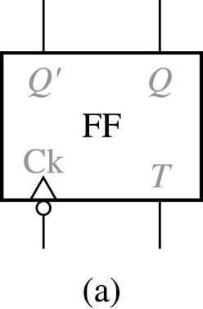


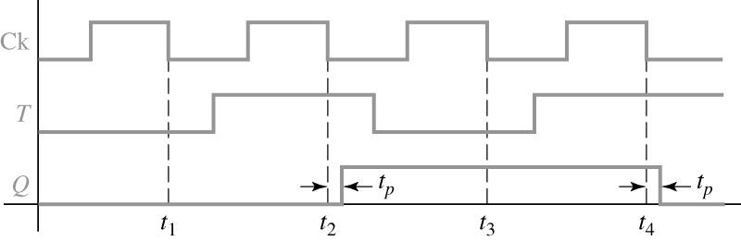
T Flip-Flop
T Flip-Flop
0 0 0 1 1 0 1 1 | 0 1 1 0
Timing diagram for a T flip-flop (falling-edge triggerred)

Slide 43
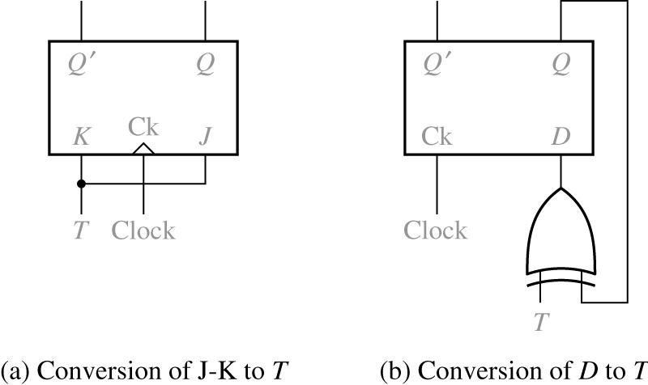
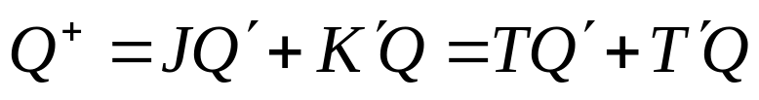
Implementation of T-FF
Implementation of a T flip-flop

Slide 44
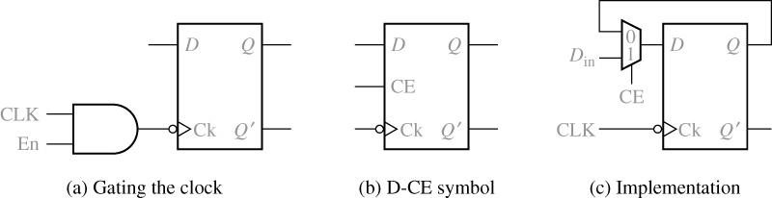


FFs with Additional Inputs
D flip-flop with clock enable
The characteristic equation :
The MUX output :

Slide 45
Asynchronous Preset/Clear
  Many times it is desirable to asynchronously (i.e., independent of the clock) set or reset FFs
  Example: At power-up so that we can start from a known state
  Asynchronous set == direct set == Preset
  Asynchronous reset == direct reset == Clear
  There may be “synchronous” preset and clear
S
D
Q
C
Q’
R

Slide 46
Asynchronous Set/Reset
Cn indicates that Cn controls all other inputs whose label starts with n.
In this case, C1 controls 1J and 1K.
S
1J
Function Table
C1
S | R | C1 | 1J | 1K | Q(t+1)
0 | 1 | X | X | X | 1 – Preset
1 | 0 | X | X | X | 0 – Clear
0 | 0 | X | X | X | Undefined
1 | 1 | ↑ | 0 | 0 | Q(t) – Hold
1 | 1 | ↑ | 0 | 1 | 0 – Reset
1 | 1 | ↑ | 1 | 0 | 1 – Set
1 | 1 | ↑ | 1 | 1 | Q(t)’ -- Complement
1K
R
IEEE standard graphics symbol for JK-FF with direct set & reset

Slide 47
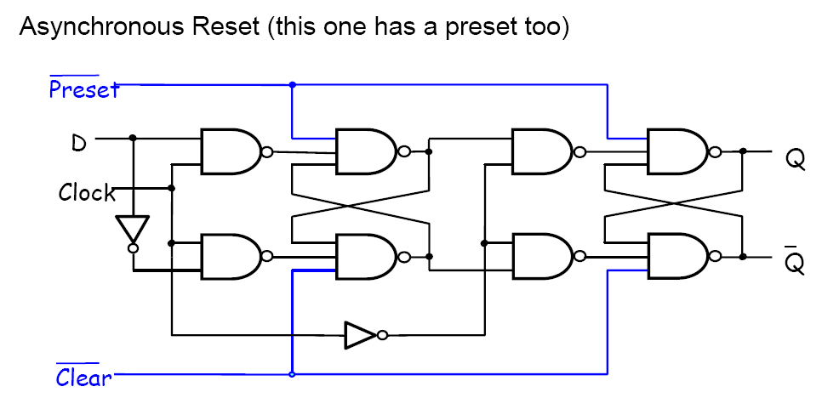
Asynchronous Inputs

Slide 48
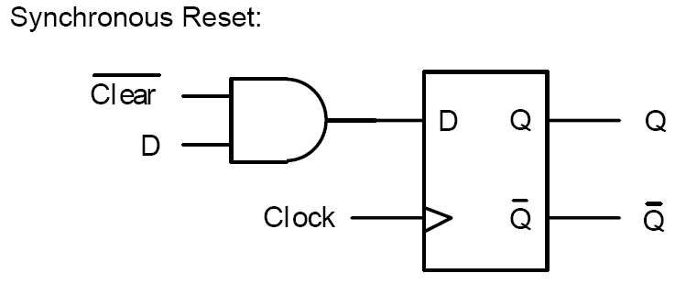
Synchronous Reset

